Slide 1
Aging
CS 8803AT Assistive Technology
April Simmons
February 20, 2017

Slide 2
Outline
Definition
Causes
Physiological Effects
Personal, Familial & Social Effects
AT Use & Acceptance

Slide 3
Definition: Stages of Life
 | 0-2 years: Infancy 2-12 years: Childhood 13-18 years: Adolescence 18-25 years: Young Adulthood 25-40 years: Adulthood 40-60 years: Middle Age
60+ Old Age | 60-65 Later Adulthood 65+ Old Age | 60-65 Later Adulthood 65-74 Young-old 75-84 Middle-old 85+ Old-old

Slide 4
Causes & Effects
Causes
  Being born
  Living past 60, or 65
Why does aging cause changes in the body?
  No definitive theory
  Damage is a popular theory
Aging affects everyone differently
  Genetics, gender, race, lifestyle, attitude
3 Types of AT

Slide 5
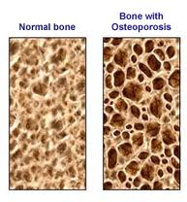
Anatomical Changes: Effects
bone loss
  results in: susceptible to fracture and osteoporosis
shrinking with age
joints become less resistant
  vulnerable to injury and to arthritis
decrease in strength, size and endurance of muscle tissue
diminished skin cells
  skin becomes thinner and less elastic
  leads to wrinkles, bruising and tearing easier, longer to heal, more vulnerable to infection, less able to get Vitamin D from the sun
Notes:
TIME CHECK: 10 min
As you age, you lose more bone than you make
Bones become thin and susceptible to fracture
Can lead to osteoporosis which is a condition of progressive bone less that is painful, disfiguring
and debilitating
vulnerable to injury from wear and tear
repetitive motion and stress
arthritis: characterized by pain and stiffness in the joints

Slide 6
Anatomical Changes: Factors
Genetics
bad habits: smoking, drinking, sedentary lifestyle
intake of calcium and vitamin D
some medications and medical conditions
regular weight-bearing exercise
good posture
sun exposure and sunscreen use
Notes:
Genetics can play in play a part in whether you get osteo.
Caucasian and Asian women are more likely.
Certain medications and medical conditions like rheumatoid arthritis
can accelerate bone loss
On the flip side, regular weight-bearing exercise
helps reduce bone less, reduce joint pain and stiffness,
retain muscle strength and endurance
"Inactivity wreaks much more havoc on muscles than time does”
sun can cause skin damage like brown age spots and skin cancers but too much sunscreen can block your skin's ability to use the sun to produce vitamin D

Slide 7
Anatomical Changes: AT
help the elderly stay active
  e.g. more recovery time, location of equipment, alternate exercises
help with painful movement
  e.g. lifting chairs, walk-in tubs
help with reduced height
  e.g. re-arranging cupboards

Slide 8
Cardiovascular Changes: Effects
increased stiffness of the chest wall
diminished blood flow through the lungs
reduction in the strength of the heartbeat
  although the body compensates by pumping more blood per beat
  takes longer to recover from stress, shock, surprise, exertion
artery walls slowly thicken and become less elastic
  more vulnerable to normal wear and tear
  buildup of plaque restricts flow of blood to the heart and brain
  greater risk for stroke, heart attack, high blood pressure, kidney failure, etc.
diminished circulation
less able to regulate body temperature
  more susceptible to hypothermia &heatstroke
Notes:
less able to perceive cold
blood vessels in skin don't have youthful ability to conserve heat
may not be able to shiver which is heat-producing
lack the ability to dissipate normal body heat
decreased sense of thirst, so may suffer from lack of fluid

Slide 9
Cardiovascular Changes: Factors
diet rich in saturated fat and cholesterol and low in fiber
sedentary lifestyle
elevated total cholesterol levels, esp. LDL
gender
stress
technological advancement of the country you live in
Notes:
LDL is low density lipoproteins, the "bad" cholesterol
leads to plaque buildup
thought that estrogen may help keep blood cholesterol
lower risk of heart attack and stroke from clogged arteries
but after menopause, women's risk rises steadily each year
They don't know why high blood pressure is more likely with age
Studies show that less technologically advanced countries have virtually no high blood pressure with advancing age, while industrialized nations such as the United States show a steady increase.

Slide 10
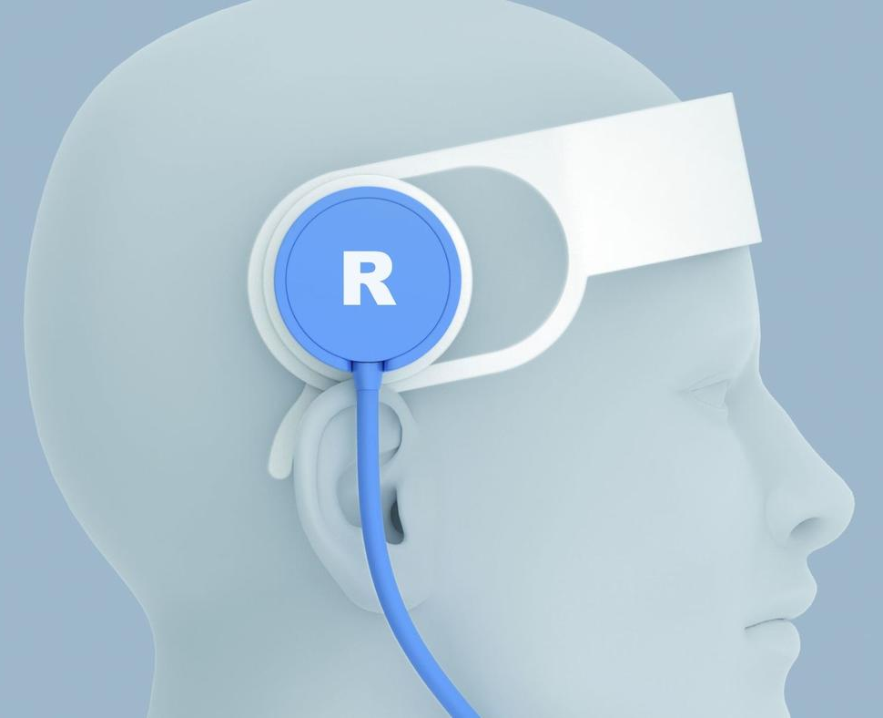
Cardiovascular Changes: AT
stroke detection
  Samsung EDSAP (Early Detection Sensor & Algorithm Package)
  BURL concepts
temperature regulation
  e.g. Nest thermostat
regular reminders to drink water
  e.g. high tech water bottles
healthy eating
  E.g. Samsung WELT
Notes:
TIME CHECK: 20 min
Around 66 % of people who have a stroke die or are left with permanent physical disabilities
EDSAP is still a prototype
a headset that records electrical impulses in the brain
mobile app that analyzes the brainwaves, determines likelihood
technology could eventually be built into glasses, hairpins
BURL concepts: portable battery powered ultrasound device for detecting and potentially treating strokes
Samsung WELT
It measures your waistline and sends alerts when you overeat.
It tracks the steps you take and the amount of time you’ve remained inactive,
and provides actionable insights based on these measurements

Slide 11
Gastronomical Changes: Effects
chewing becomes more difficult, chew more slowly, may not chew as efficiently
esophagus doesn't contract as forcefully
  wallowing larger pieces of food
  takes about 50 to 100% longer to make its way to your stomach
  more vulnerable to choking
some don't produce enough or any stomach acid due to gastritis
  faulty vitamin B12 absorption
  anemia, irreversible nervous-system impairment, risk factor for heart disease
prone to gallstones
prone to lactose intolerance
gut/colon becomes sluggish and less toned
  vulnerable to constipation
liver shrinks
  handle certain medications differently
  prone to ulcers
kidneys shrink

Slide 12
Gastronomical Changes: Factors & AT
slowing down and chewing food thoroughly
amount of fat in diet
consuming dairy products with food, or smaller amounts
drinking plenty of fluids
AT: apps for detecting lactose
  e.g. Dairy Free Fast Food
Notes:
TIME CHECK: 26 min
fluids helps preserve kidney function

Slide 13
Immunological Changes
decreased immunity by impairing production of antibodies
shrinking thymus gland
increase possibility of confusion in immune system
  body will turn against itself and destroy its own tissues
  autoimmune diseases such as rheumatoid arthritis or lupus
Factors: eating healthy, exercising, good habits
AT: help with moving around, performing (I)ADL's
  reachers
  orthotics
  replacing small switches and doorknobs
  rearranging the house
Notes:
thymus gland: produces hormones that keep our immune system intact

Slide 14

Metabolic Changes
muscle mass and body water decreases
basal metabolic rate (BMR) decreases
body fat increases
  greater risk for heart disease, developing certain cancers, and diabetes
  aggravates arthritis
Factors:
  age: begins around age 25
  onset of menopause
  where you store extra fat
Notes:
BMR is rate at which you burn calories
dependent upon body composition
more muscles, more calories you burn
muscle requires more calories than fat to sustain itself
when ovaries stop producing estrogen, muscle mass may diminish
greater risk for heart disease if shaped like an apple
store fat in mid-section
rather than a pear: store weight in hips and buttocks

Slide 15
Respiratory Changes
lungs become less elastic and chest wall stiffens
  can't cough as forcefully
  diminishes ability to clear germs from lungs
  prone to upper respiratory infections
  Factors: smoking
difficulties swallowing
  increases the chance of aspirating particles of food into lungs
  can cause pneumonia
lung function and capability drop off with time
  major predictor of disease and death
  Factors: regular aerobic exercise, intake of vitamin C
AT: helping with swallowing e.g. Guardian Therapy
Notes:
TIME CHECK: 30 min
well-conditioned older people may reach levels of lung function that
exceed those of much younger people
loss of pulmonary function is a major predictor of disease and death
in older adults

Slide 16
Sensory Changes: Eyesight
weakening eyesight
  decreasing ability to focus on nearby objects
tissues surrounding eyes lose their tone and fat
  droopy upper eyelids and turning outward or inward of the lower lid
  prone to cataracts
pupils get smaller, lenses accumulate yellow substances
  prone to glaucoma which can lead to vision loss and blindness
  Factors: African-Americans, family history
decreased blood flow to the retina
  leads to macular degeneration
AT: glasses, contacts, surgery
Notes:
cataracts: cloud your vision by preventing light from getting through the clear lens of the eye
pupils: the black holes in the iris that respond to light
glaucoma: the product of excessive pressure inside your eyeball
cataracts form at a snail's pace, painloss
glaucoma is symptom-free until it's too late
retina: paper thin lining the back of your eyeball

Slide 17
Sensory Changes: Hearing Loss
hearing loss at all frequencies
  reduced ability to detect changes in pitch of sounds
  makes your speech less understandable
  Factors: gender
walls of ear canal thin out
eardrum thickens
hair cell loss in the inner ear
  Factors: nerve damage, injury, exposure to loud noise, certain medications
AT: anything that helps with hearing
Notes:
Men are more prone to hearing loss

Slide 18
Sensory Changes: Smell & Taste
lessened sense of smell
  trouble savoring the flavor of food
Factors:
  zinc deficiency
  damage from infections
  some medication
AT: (see previous discussion)
Notes:
sense of small changes vary from person to person
your sense of taste for sweet, salty, bitter, and sour foods may be remarkably intact until you're well into your seventies??
zinc deficiency can cause a decreased sense of taste
some damage from infections such as flu, colds
can be permanent

Slide 19
Cognitive changes
memory lapses
information processing slows
trouble multitasking
may lead to:
  mild cognitive impairment (MCI)
  Alzheimer's
Affected by: physical activity, healthy diet, mentally stimulating activities, social interaction, high blood pressure
AT: (see previous discussion)
Notes:
Alzheimer's includes trouble with language or recognizing objects
social interactions wards off depression and stress
which can contribute to memory loss
smoking in middle age and older might increase your risk of dementia

Slide 20
Interactions with Disability
Age-acquired disability
Aging with disability
Notes:
TIME CHECK: 40 min

Slide 21
Personal, Familial & Social Effects
Personal effects
  Ability to perform ADL, IADL, EADL
  Independence & dignity
  Self-concept
  AT: ADL technologies, whole home technologies
Familial effects
  Caregivers, role in the family
  AT: aimed at caregivers, virtual visits, afterwards
Social effects
  Reduced social opportunities
  AT: increased mobility, virtual visits
Notes:
Instrumental activities of daily living

Slide 22
AT Use & Adoption
  Design
  SES
  Gender
  Race
  Culture

Slide 23
AT Use & Adoption - cont’d
Human Barriers
    Lack of information and knowledge
    Safety concerns
    Failing to meet perceived needs
    Concern of losing functional capabilities
AT Barriers
  Complexity of AT
  AT experienced as obstacles
  Device Failure
Context Barriers
  Financial Limitations
  Physical Environment Limitations
Notes:
Actually AT can help reduce functional decline
And improve well-being by promoting independence
And reduce depressive symptoms
And increase levels of social participation

Slide 24
Benefits of Aging
Less negativity – higher self esteem
Greater emotional stability
Clearer priorities
Wiser perspective
Better able to see big picture
Brain plasticity
Knowledge
AT needed: has fun with aging
Let’s put the “It’s On” back in gerONtology!
Notes:
Science now knows that our brains continue to grow neurons as we age and can reshape itself in response to what it learns
Retirement
Senior Discounts
Wisdom
Perspective
Not giving a sh*t

Slide 25
Questions?
Old age is no place for sissies. -- Bette Davis
Age is an issue of mind over matter. If you don't mind, it doesn't matter. -- Mark Twain or Jack Benny
Old age isn't so bad when you consider the alternative. -- Maurice Chevalier
Laughter is timeless. Imagination has no age. And dreams are forever. -- Walt Disney

Slide 26
References
http://www.widener.edu/about/campus_resources/wolfgram_library/documents/life_span_chart_final.pdf
http://health.howstuffworks.com/wellness/aging/aging-process/aging.htm
http://www.webmd.com/healthy-aging/features/normal-aging-changes-and-symptoms?page=43
http://www.mayoclinic.org/healthy-lifestyle/healthy-aging/in-depth/aging/art-20046070?pg=2

