Slide 1
Assistive Technology
Tasks at Work
Malia Crane
Diego Osorio

Slide 2
Regulations
Disabilities and work is enforced by the USA’s Equal Employment Opportunity Commission
Americans with Disabilities Act (1990)
United Nations Convention on the Rights of Persons with Disabilities
Article 27: (i) Ensure that reasonable accommodation is provided to persons with disabilities in the workplace;
http://www.un.org/disabilities/documents/convention/convention_accessible_pdf.pdf

Slide 3

Universal Design
Design for Inclusion:
Creating a New Marketplace

Slide 4
Job Accommodation Network
U.S. Department of Labor's Office of Disability Employment Policy (ODEP)
https://askjan.org

Slide 5

EARN
Employer Assistance and Resource Network on Disability Inclusion
http://www.askearn.org/topics/creating-an-accessible-and-welcoming-workplace/

Slide 6

Assess technology accessibility practices
http://www.peatworks.org/action-steps
https://youtu.be/2M06CPbVnpU

Slide 7
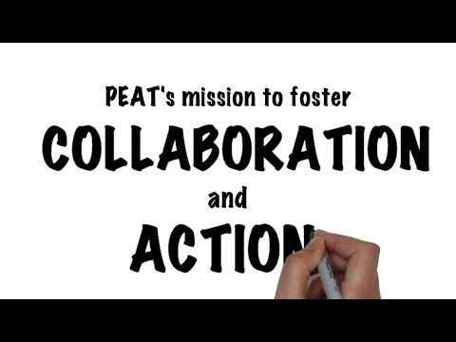

Slide 8


At Georgia Tech
Enabling Environments Lab
Assistive Technology Lab
Accessible Information and Communications Technology Lab
http://catea.gatech.edu
Accessible Materials Solutions
Assistive Technology
Compliance, Training and Technical Support
Honored as a Leader in Digital Accessibility at the United Nations
http://www.amacusg.org/

Slide 9
Employment access and inclusion
People with a disability are employed at a lower rate and make less money than people without a disability:
Employment levels of people with disabilities are low, and those who are employed tend to be in low-paying occupations.
There is nonetheless substantial potential for job growth among people with disabilities in well paying occupations over the coming decade.
42.8% Rate of Employment Gap
$6,000 Income Gap
Source: https://www.dol.gov/odep/pdf/20141022-KeyPoints.pdf

Slide 10
Can be anything!
According to the Technology-related Assistance to Individuals with Disabilities Act of 1988:
AT device is any item, piece of equipment, or product system whether acquired commercially off the shelf, modified or customized, that is used to increase, maintain, or improve functional capabilities of individuals with disabilities.
AT service is any service that directly assists an individual with a disability in the selection, acquisition, or use of an assistive technology device.

Slide 11
AT Services
Assessment
http://www.peatworks.org/techcheck
Orientation and Mobility
Driver Rehabilitation
Job Coaching
Pride Industries Foundation (http://www.prideindustriesfoundation.org/)

Slide 12
General Categories of Impairments
Gross or Fine Motor Impairments
Blind/Low Vision
Deaf/Hard of Hearing
Speech/Language Impairments
Cognitive/Neurological Impairments

Slide 13
Vision/Hearing Impairments
Blind/Low Vision
Screen magnification
Screen readers
Optical character recognition (OCR)
Deaf/Hard of Hearing
Portable text communicators
  Cell Phones
Voicemail transcription

Slide 14
American Foundation for the Blind
Computer and Internet Use
Low Vision:
Magnification programs for the computer screen
Tips for Computer Users with Low Vision
Low or No Vision:
Speech systems
Web Accessibility

Slide 15
American Foundation for the Blind
Taking Notes and Writing
Low or No Vision:
See Computer and Internet Use
Braille Systems
Accessing a Telephone
Low or No Vision:
How to Get an Accessible Telephone

Slide 16
Cognitive/Lingual
Cognitive impairment/Learning disability
Reading and writing support
Mathematical software
Organization software
Augmentative and Alternative Communication (AAC) devices

Slide 17
Motor Impairments - Alternative input devices
Conventional Inputs:
  Keyboards
  Mouse
Touch-free Colors/Contrasts
Switches
Breath and Mouth Inputs
Eyegaze Technology
Text to Speech / Voice Recognition
Touch Screens

Slide 18
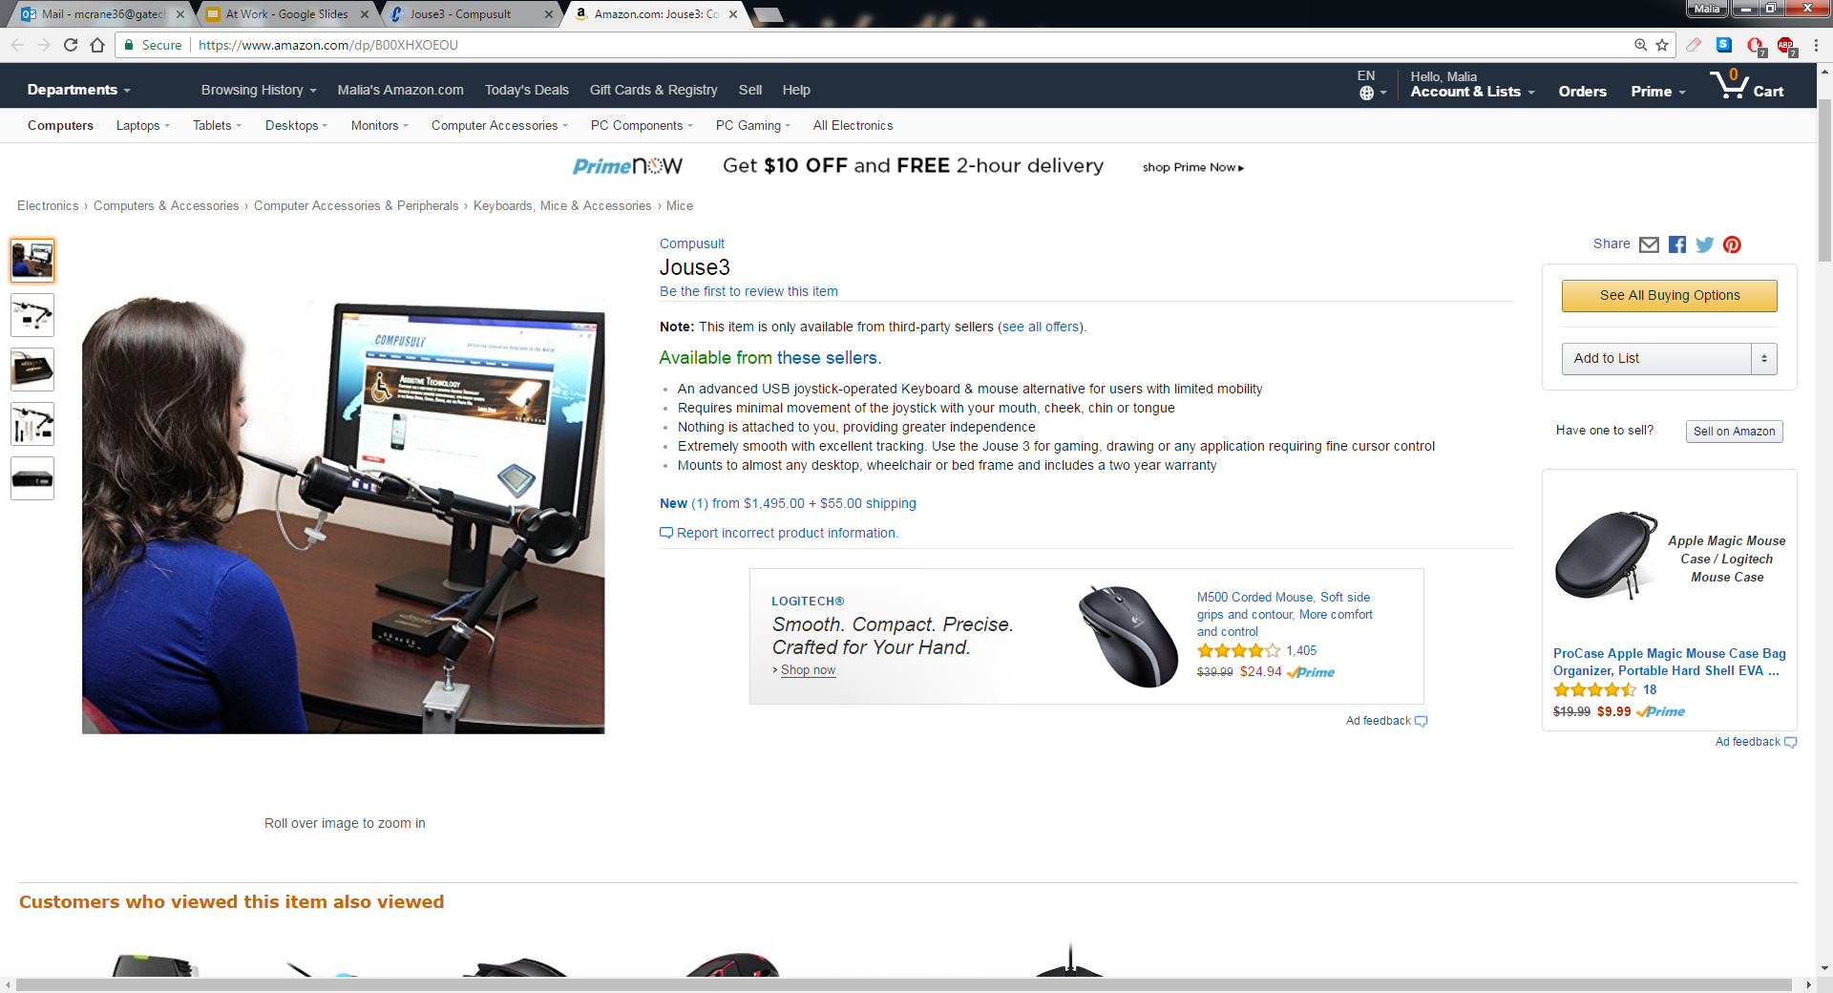
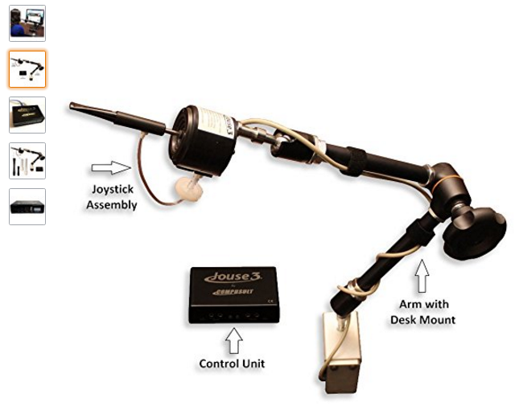
Mouth Input

Slide 19
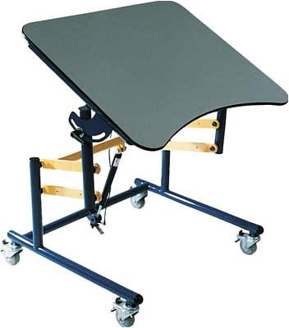
Low Tech
Workspace modifications
Accessibility adaptations
Adjustable tables
Custom designed or modified products
Tasks instructions and adaptations

Slide 20
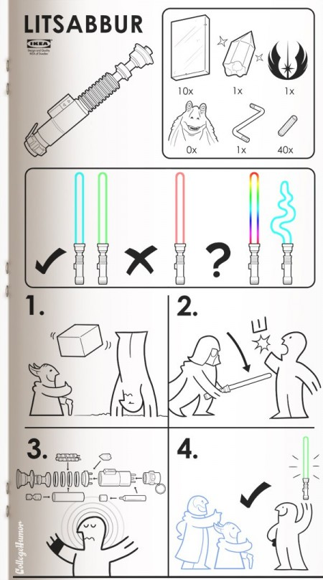
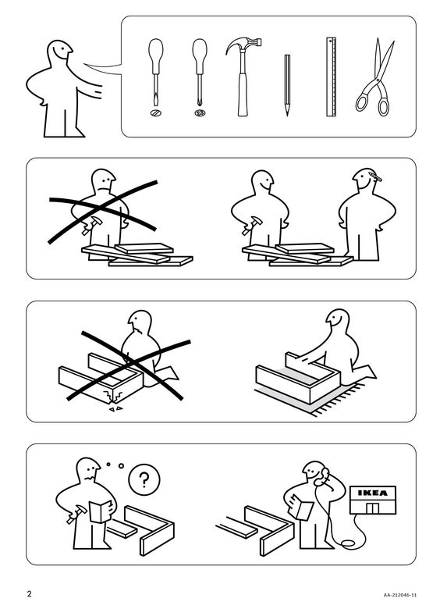
Specific instructions

Slide 21

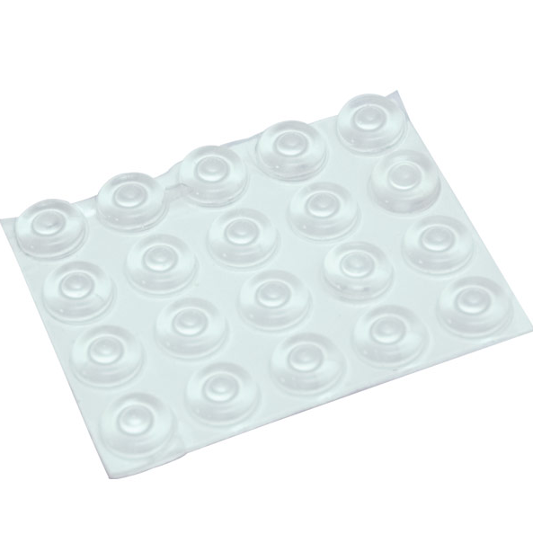
Low Tech - Low cost
Writing, gripping, typing aids
Checklist
Timers and watches
Line guide
Calendar
Locator dots
Color-coded items
Picture boards for communication

Slide 22
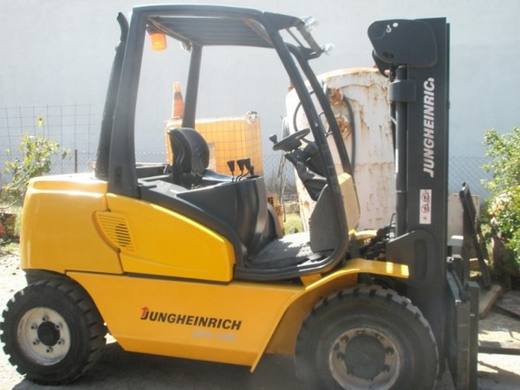
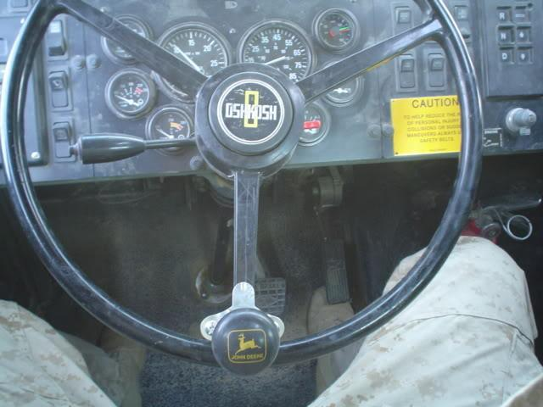
Arthritis - Spin wheel

Slide 23
Disabilities and Work, Examples of Tasks
Chef
Farmer
Hunter
Sports

Slide 24
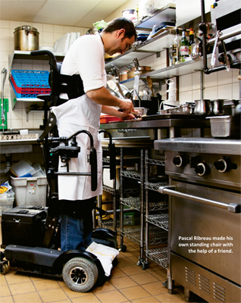
Chef
https://easystand.com/

Slide 25
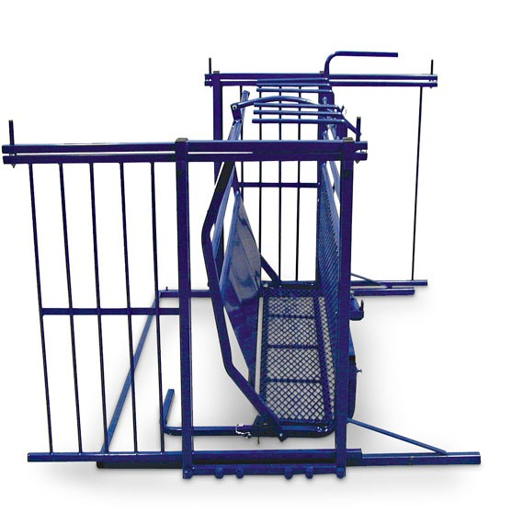
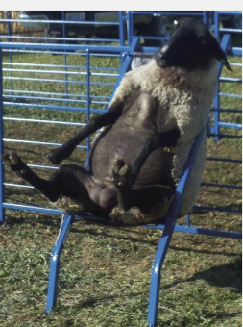
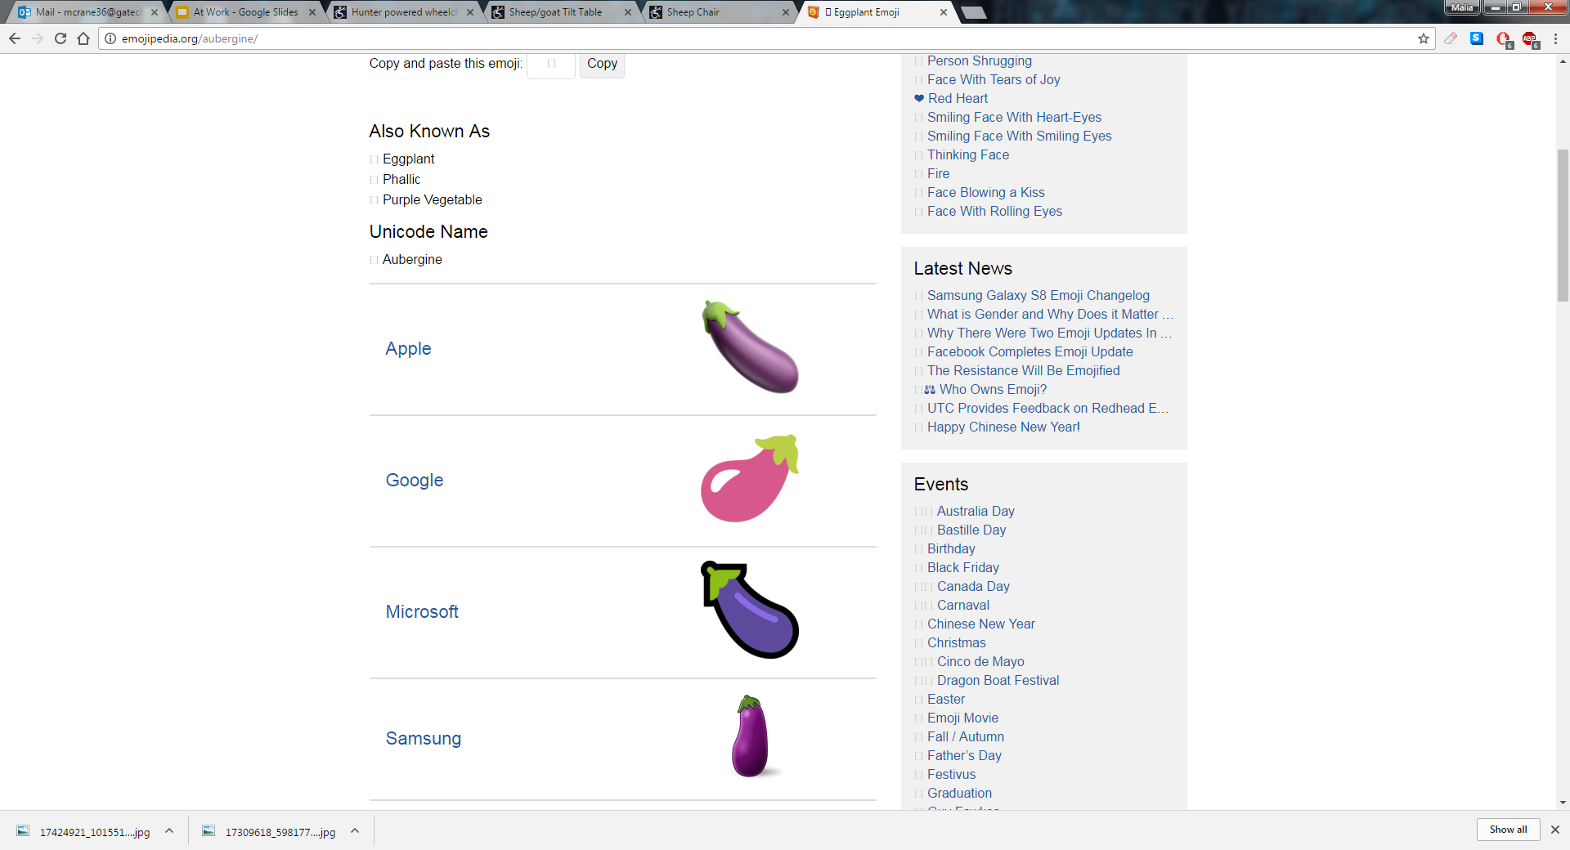

Farmer: Maintaining animal hooves with motor and memory impairment
Sheep/Goat Rotator!
Sheep Chair
http://disabilityworktools.com/shop-by-enterprise/farming/sheep-goat-tilt-table/

Slide 26
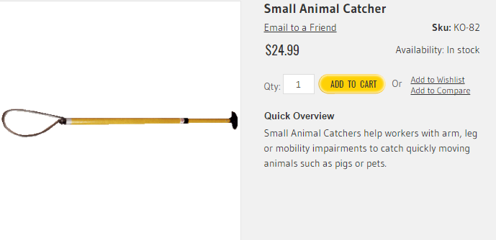
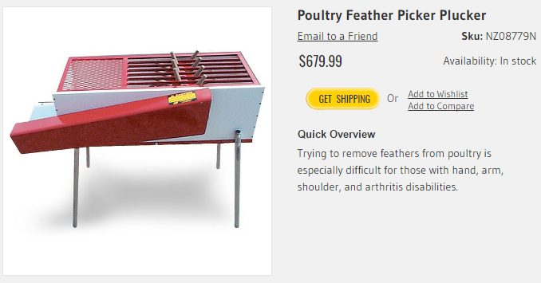
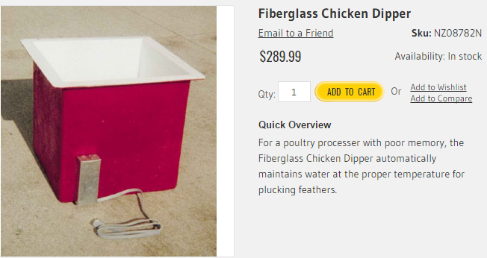
Farmer plucking chickens with motor and memory impairment

Slide 27
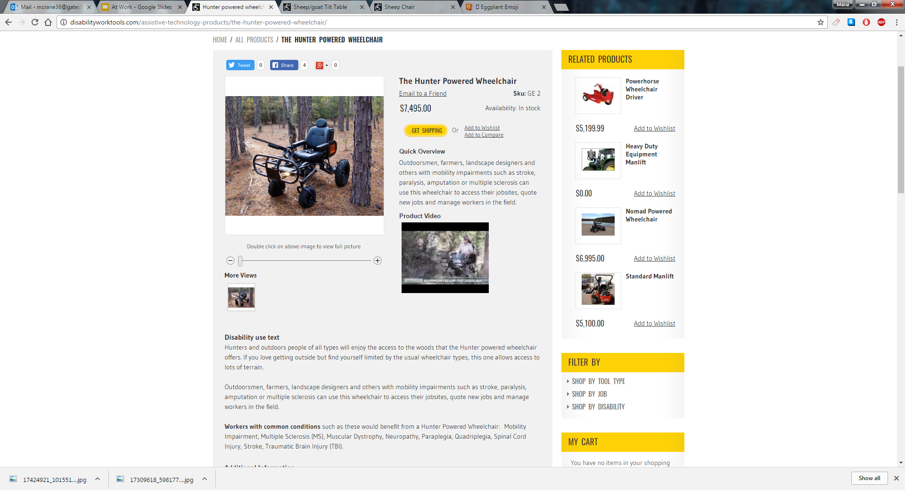
Bonus
Hunter Powered Wheelchair
http://disabilityworktools.com/the-hunter-powered-wheelchair/

Slide 28
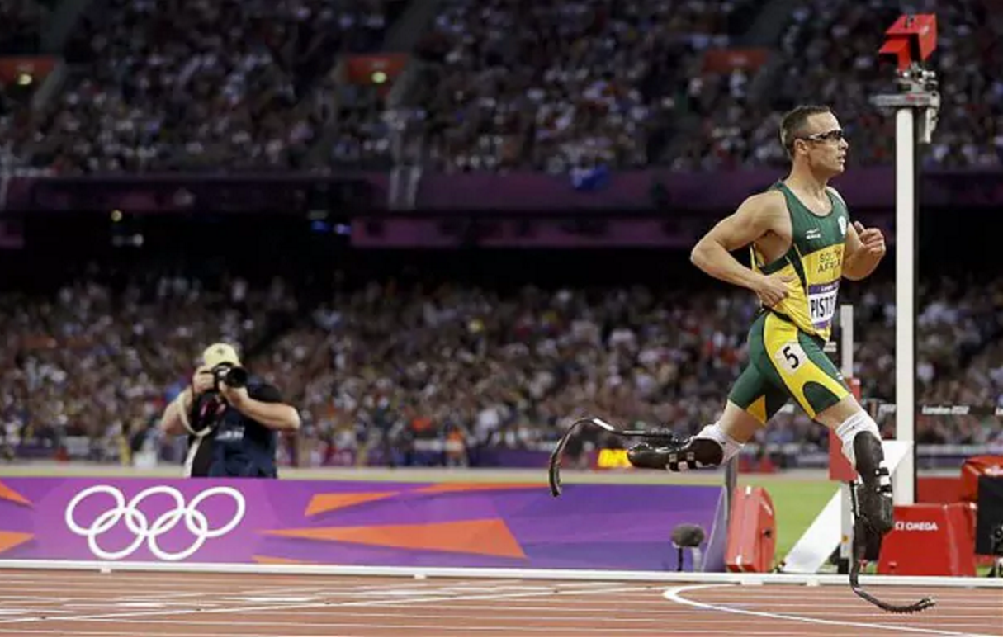
Assistive Tech and Olympics
South african double amputee 400m runner with running blades
Successfully fought for right to compete against traditional athletes
https://youtu.be/vB_g-RSIGfM?t=180

