Slide 1
Mobility and Transportation
Samuel Cheng
David Grimm
March 6, 2017
Notes:
In previous lectures, we’ve talked about movement and mobility when it comes to short distances. Within the home, within the confines of a building or a sidewalk. Now, we want to look at transportation over long distances.

Slide 2
Why is Transportation so Critical?
Notes:
Ask this to the class.

Slide 3
Why is transportation so critical?
Enables access to desired community venues.
Gives the opportunity to engage in desired occupations.
Inaccessibility leads to decreased living conditions:
  Financial difficulties.
  No access to education, healthcare, recreational activities, etc.
  Mental health issues, social isolation of themselves and caregiver.
People have a right to transportation (UN Convention on the Rights of Persons with Disabilities)

Slide 4
Human Component
Motor Impairments
-Affect ability to sit upright, or have strength and ROM to use a car
Visual Impairments
-reduction in visual field & peripheral FOV
Hearing Impairments
-Reduction in awareness to relevant noises, e.g. honking
-Considered less critical than visual impairments
Reaction Time
Cognitive Impairment
Memory, judgment, executive functioning
Multitasking is common problem in driving, exacerbated by cognitive impairment
Age
-Age alone is not a predictor of safe driving, but the presence of disabling conditions are a mediator

Slide 5
Original Equipment Manufacturer (OEM)
Individuals with disabilities may not be able to use the OEM controls
Range of motion, strength, coordination can prevent use of OEM
  E.g. spinal cord injury patients may not have full sensation to use brake and accelerator pedals
  Individuals with musculoskeletal conditions may have limited ROM to exert enough force

Slide 6
3 Activities Related to Transportation
Occupant protection
  That which secures and safely positions the person in the vehicle.
  Seatbelt, headrests, etc.
Vehicle ingress and egress
  Differs depending on whether or not an occupant remains in a wheelchair
  Automated ramps, lifts, etc.
  Also preventing unintentional egress.
Driving
  Primary activities (steering, acceleration)
  Secondary activities (using lights, setting emergency brake, etc.)
  Both types of activities must be taken into account for design and assessment purposes

Slide 7
Occupant Protection - Children
Children less than 40 lbs. must use a child restraint safety system
Rear facing infant seats must be used from birth to 12 months or 22 lbs.
Forward facing restraint systems must be used to accommodate children up to 40 lbs. and 40 inches in height.
After 40 lbs., they can move to a booster seat
Children are ready for seat belts at 80 lbs. and at least 4’9”.

Slide 8
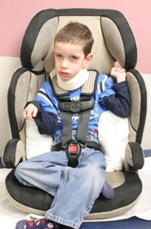
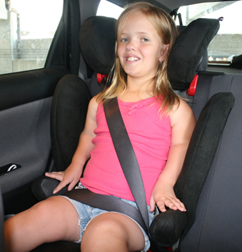
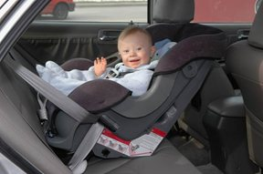
Examples of Occupant Protection - Children
Backward facing
Forward facing
NHSTA’S Register Your Car Seat program
  Ensures parent’s car seats are safe.
  https://www.safercar.gov/parents/CarSeats/Car-Seat-Types.htm?view=full
http://www.preventinjury.org/Special-Needs-Transportation/Child-Seats-for-Children-with-Special-Needs

Slide 9
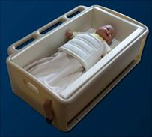
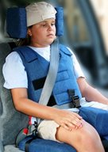
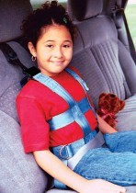
Specialized Examples of Car Seats
Car beds
Adaptive belt positioning booster
  Provides additional support
Vests
  Can be used as AT for children up to 168 lbs.
http://www.preventinjury.org/Special-Needs-Transportation/Child-Seats-for-Children-with-Special-Needs

Slide 10
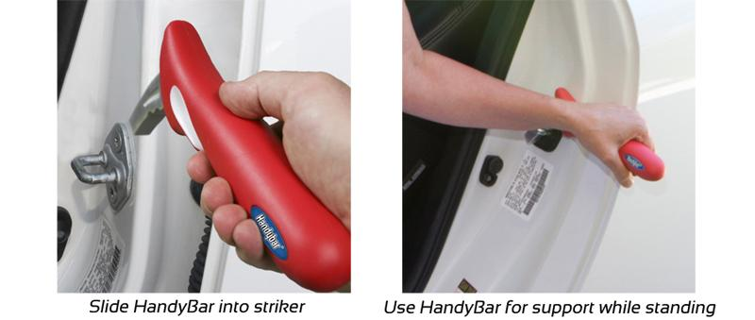
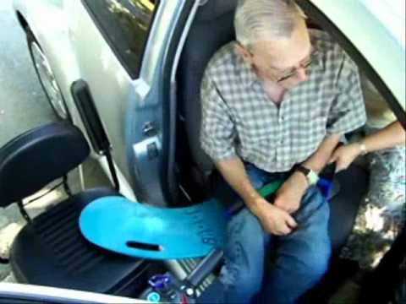
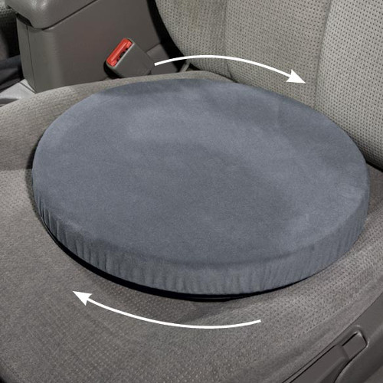
Vehicle Ingress and Egress
Having the height of the seat match hip height
Wide door opening
A handle to steady themselves
Transfer boards (video)
Seat swivel
Notes:
Video time 7:17

Slide 11
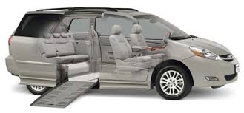
Vehicle Ingress and Egress (cont.)
Van modifications usually have ramp for access and tie­down system for wheelchair.
  Either side or rear access.
  Must keep wheelchair dimensions and turning radius in mind.
Must have space for restraint system and for the caregiver/adult to maneuver to secure occupant.
Notes:
Video time 7:17

Slide 12
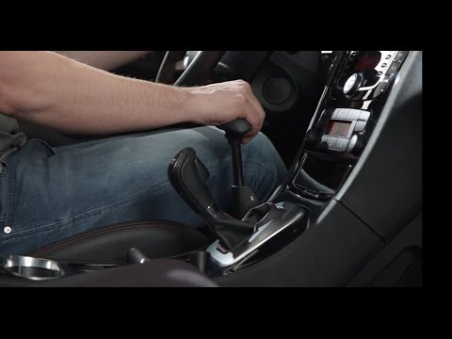
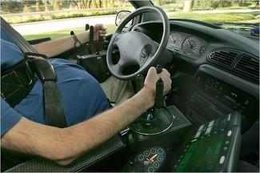
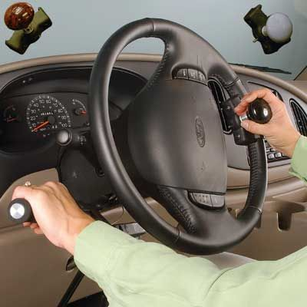
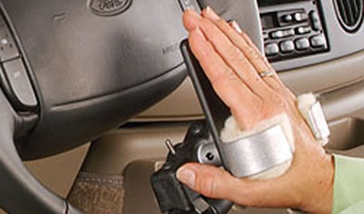
Driving
Primary driving controls
  Stop (brakes), go (accelerator), steer
­Pedal hand controls (video)
Pedal extensions
Reduced diameter wheel
Modified steering
Notes:
Steering Knobs are employed for positive, one-hand control, adjustable to one's ability.
Drivers with no grip or diminished wrist stability can use tri-pins, a three-pronged grip for the wheel.
A steering cuff offers complete support and control for a driver with a totally disabled hand and wrist.
A palm grip, v-grip or quad fork is used with some quadriplegics for steering. It is placed at any position on the wheel according to the prescription and driver's personal comfort.
An amputee ring accommodates drivers with a prosthetic hook on their steering arms. (The prosthesis should have soft surface pinchers.)
Modified-effort steering reduces strength needed to operate power steering or brakes for someone with low strength or endurance.
Floor-mounted steering is a floor steering wheel for foot control.

Slide 13
Assessment
A driving is evaluation can be used for individuals who have had their licence removed due to an illness.
Driving evaluation has two components: off road assessment and on road component.
It should include cognitive, physical, visual and perceptual elements. Medical and driving histories are recommended.
Canadian group led by Korner-Bitensky et al., 2005 recommended the following:
  Stopping at a light/stop sign, right & left turns, merging & accelerating into traffic, reverse, variety of speed limits

Slide 14
Evaluation Outcome
The driving evaluation can be one of the following outcomes:
  The user has the skills to continue driving safety
  The individual does not have the skills to continue dirivng safely
  The individual has basic skills, and can continue with a driver training program
  The individual has specific impairment that limits driving ability, and they must be trained and assessed with adapted driving controls.

Slide 15
Thank you!
Notes:
Steering Knobs are employed for positive, one-hand control, adjustable to one's ability.
Drivers with no grip or diminished wrist stability can use tri-pins, a three-pronged grip for the wheel.
A steering cuff offers complete support and control for a driver with a totally disabled hand and wrist.
A palm grip, v-grip or quad fork is used with some quadriplegics for steering. It is placed at any position on the wheel according to the prescription and driver's personal comfort.
An amputee ring accommodates drivers with a prosthetic hook on their steering arms. (The prosthesis should have soft surface pinchers.)
Modified-effort steering reduces strength needed to operate power steering or brakes for someone with low strength or endurance.
Floor-mounted steering is a floor steering wheel for foot control.

