Slide 1
Motor/Mobility
Bum Jun (Todd) Park

Slide 2
Outline
Seating
  Poster Control
  Tissue integrity
  Seating Technologies
Mobility
  Components/Assessments
  Assistive Technology: Wheelchairs

Slide 3
Posture Control
Cerebral palsy and Neuromuscular disorders
Stability
  Sliding forward in the seat or lateral or anterior trunk flexion
Spinal Cord Injury (SCI)
  Individuals with low or absent tone cannot maintain a sitting position b/c of loss of strength and endurance.

Slide 4
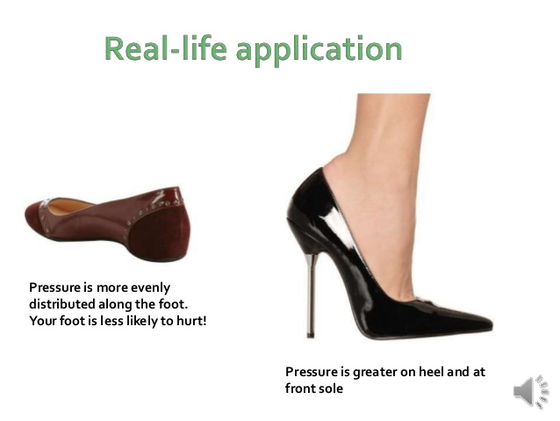
Tissue Integrity Pressure Redistribution
Pressure Ulcer
  Injury to skin and underlying tissue resulting from prolonged pressure on the skin
  Approx. 25% of the health care costs of a SCI patient
Pressure Redistribution

Slide 5
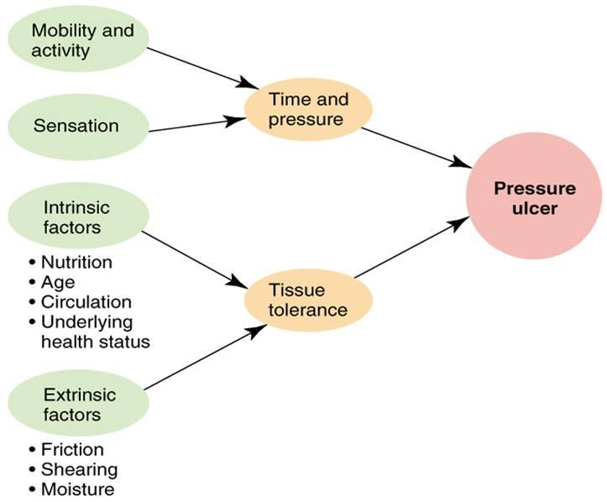
Pressure ulcer risk factors
Notes:
Talk about shearing and friction

Slide 6
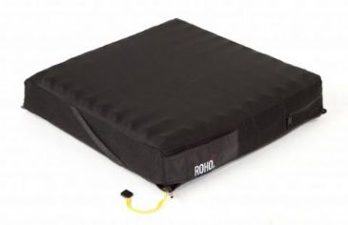
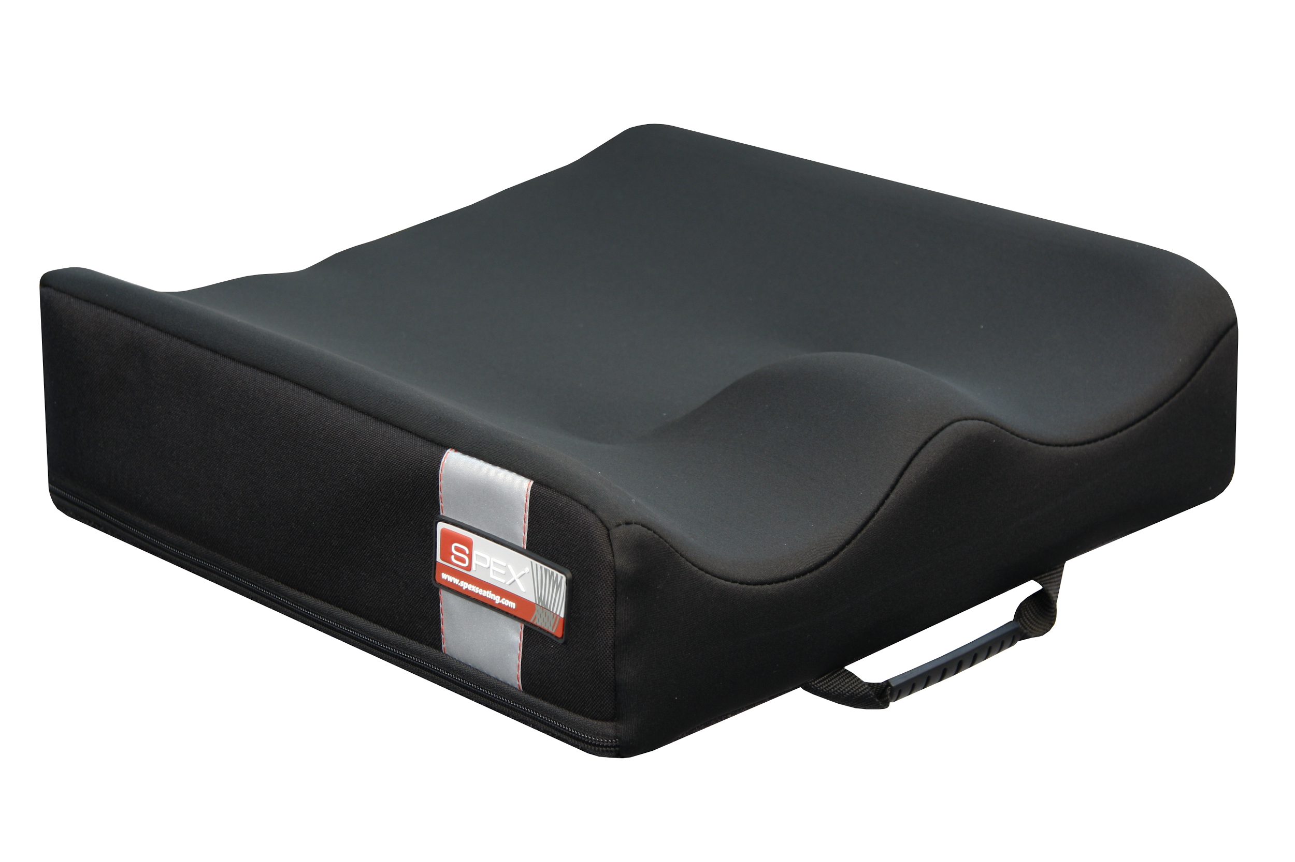
Seating Technologies
Planar Cushions
Contour Cushions
Notes:
Properties: Density, Stiffness, Sliding resistance, Resilience, Dampening, Recovery and even cushion cover.

Slide 7
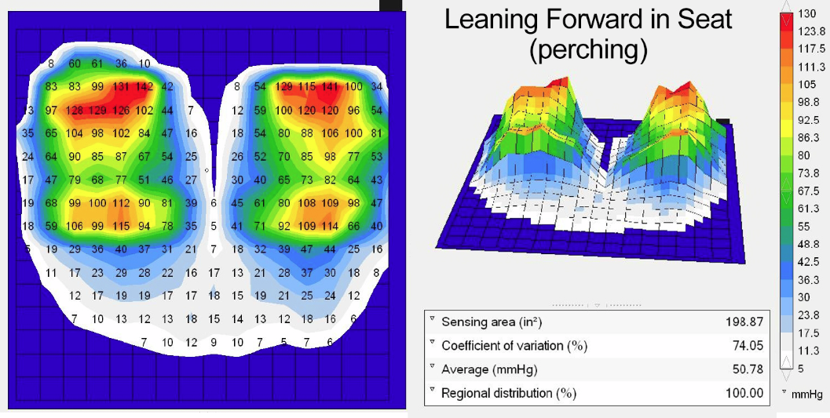
Pressure Measurements
Pressure mapping
Notes:
Swaine’s work provides a useful basis for clinicians using pressure mapping to determine the optimal cushion for their clients.

Slide 8
Seating Assessment
Seating Assessment Framework
Technologies for Postural Control
Outcome of Needs Identification
Outcomes of Skills Evaluation
Matching
Technologies for Pressure Management
Technologies for Comfort
Notes:
A single assessment is used to gather information to make a recommendation for seating and mobility
AT professionals went through the decision-making process and ultimate selection of seating and positioning technologies that match the needs and kills of the user.
Also, can personalize them

Slide 9
Human Factors
Orthopedic Factors
Postural Control
Respiratory and Circulatory Factors
Sensory and Perceptual Skills
Cognitive skills
Psychosocial Factors

Slide 10
Guidelines for Postural Control
Pelvis and Lower Extremities
  Pelvic obliquity & Pelvic rotation
Trunk
Head and Neck
Upper Extremities

Slide 11
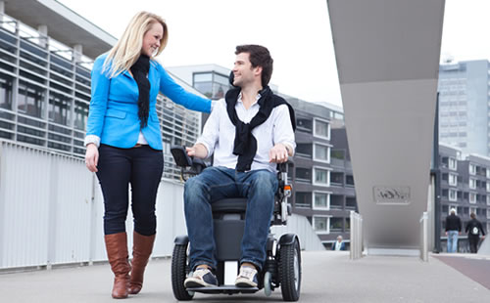
What do we mean by mobility?
Notes:
Americans are sitting an average of 13 hours a day and sleeping an average of 8 hours resulting in a sedentary lifestyle of around 21 hours a day

Slide 12
Components
Activity
  Identifies the occupations
  Frequency of use of the wheelchair
Human
  Older adults
  Obesity
  Accessibility legislation
Context
  Physical
  Social
  Cultural
  Instituional

Slide 13
Assessment for Wheeled Mobility
Needs Assessment
  The most appropriate wheeled mobility for activities which the individual’s wishes to engage.
  The clinician determines which activities are important and necessary for the users
Factors to consider when selecting a wheelchair
  Consumer profile: disability, date of onset, prognosis, size, and weight
  Consumer needs: activities, contexts of use, preferences, transportation, reliability
  Physical and sensory skills: range of motion, motor control, strength, vision, perception
  Functional skills: Transfers and ability to propel

Slide 14
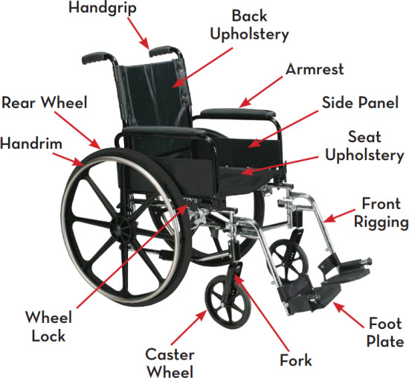
Anatomy of a Wheelchair

Slide 15
Cool Wheelchair videos
Moto+ wheelchair
https://www.youtube.com/watch?v=3NUjnIeAlJg
Future Wheelchair
https://www.youtube.com/watch?v=WiJNLhDxmXs
https://www.indiegogo.com/projects/hovering-steprover-new#/ Crowdfunding

Slide 16
Types of Wheelchairs
https://www.karmanhealthcare.com/different-types-of-wheelchairs/
http://www.topendwheelchair.com/our-chairs/
Notes:
Talk about reclined and standing wheel chairs!

Slide 17
Powered Wheelchairs Safety
The National Institute for Rehabilitation Engineering (NIRE) report
High injury rates are reported for disabled people using power wheelchairs
Recommendations
  Never buy a mobility aid from an advertiser or vendor without first having it recommended by a physician or therapist
  Have the seller visit the user at his/her residence: to adjust it to fit the user
  Arrange for a mobility trainer
  Make it a firm policy to never attempt to drive the mobility aid under conditions that are new to you, such as at the beach or outdoors.
Source (http://www.schepens.harvard.edu/images/stories/nire/mobility-training.pdf)
Notes:
http://www.schepens.harvard.edu/images/stories/nire/mobility-training.pdf

Slide 18
Questions?
Cool Powered Wheelchairs
Extreme
https://www.youtube.com/watch?v=oVs_4dtNERY

