Slide 1
Categories of Impairment: breathing, obesity, & chronic conditions
Rachel STuck

Slide 2
Breathing
Chronic Obstructive Pulmonary Disease (COPD)
  Emphysema:
    Symptoms: shortness of breath, cough, difficulty breathing, exhaustion, weight loss, depression, fast heartbeat
  Chronic Bronchitis:
    Symptoms: shortness of breath, cough, wheezing, chest pain, chest tightness, sore throat,
Asthma:
    Symptoms: coughing, wheezing, difficulty breathing, chest tightness, fatigue
Comorbidities for COPD & Asthma:
    high blood pressure, impaired mobility, insomnia, sinusitis, migraine, depression, stomach ulcers, cancer
https://www.youtube.com/watch?v=15DBE6giDUA

Slide 3
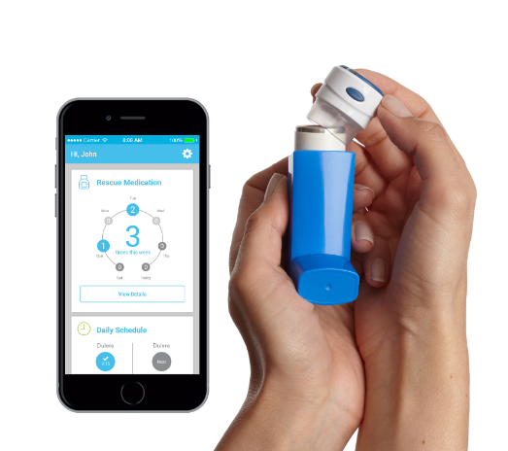
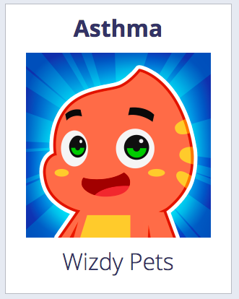
Assistive Technology for Breathing
Propeller:
https://www.propellerhealth.com/
Wizdy Pets:
http://wizdygames.com/apps/wizdypets

Slide 4
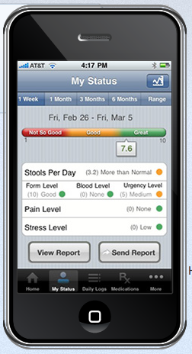
Physiological Impairments & Assistive Technologies
Fibromyalgia
  Symptoms: widespread pain, fatigue, cognitive difficulties, depression, headaches,
  Assistive Techs: mobility aids (walkers, wheelchairs, scooters) braces or splints, orthotics,
Gastro-intestinal disease
  Symptoms: chronic abdominal pain, hiccups, nausea/vomiting, rumination, constipation, diarrhea, gas
  Assistive Techs: health monitoring app

Slide 5
Physiological Impairments & Assistive Technologies
Chronic Fatigue Syndrome
  Symptoms: extreme fatigue that does not improve with rest (no known cause)
  Assistive Techs: MyTherapy (disease management app)
Cancer
  Symptoms: fatigue, weight changes, cough, difficulty swallowing, persistent indigestion, unexplained joint/muscle pain, unexplained bleeding/bruising
  Side effects of Radiation: fatigue, irritation of skin, long term-heart problems
  Side effects of Chemotherapy: headaches, stomach pain, muscle pain, peripheral
  Assistive Techs: listed wigs, prostheses
    Do these count as assistive technologies?

Slide 6
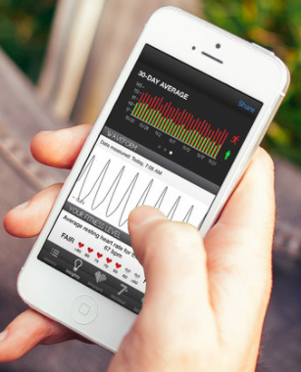
Heart Disease
Ischemic Heart Disease
  Symptoms: chest pain, chest pressure, shortness of breath
  Assistive Techs: health management apps
Other General Heart Disease Symptoms
  angina (chest pain sometimes radiating down the left arm or into the jaw);
  sensations of fluttering, thumping, pounding, or racing of the heart (palpitations);
  edema (swelling and fluid retention in the legs, ankles, abdomen, lungs, or heart);
  lightheadedness, weakness, dizziness, or fainting spells;
  breathlessness;
  chronic fatigue; and
  gastric upset (or nausea)
Notes:
https://www.healthgrades.com/conditions/ischemic-heart-disease--symptoms

Slide 7

Diabetes
Type I
  Symptoms: extreme fatigue that does not improve with rest (no known cause)
Type II
  Symptoms: dry mouth, blurred vision, fatigue, slow healing cuts, yeast infections, urinary tract infections, itchy skin
Assistive Techs:
  Vision aids (magnifiers)
  Portion plate
  Glucose monitor
  Watch/PDA reminder

Slide 8
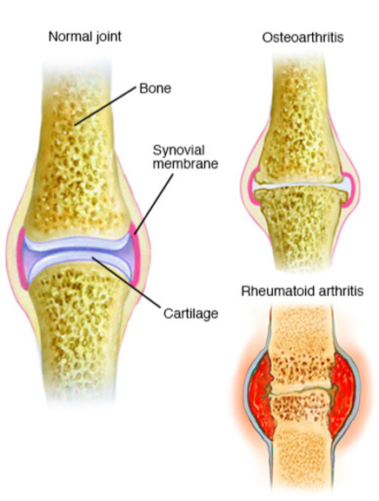
Arthritis
Symptoms:
  Fatigue
  Joint: pain, tenderness, swelling, redness, warmth, stiffness
  Loss of joint range of motion
  Limping
  Joint deformity
  Loss of joint function
  Anemia
  Fever
  https://www.youtube.com/watch?v=DQrEK7BWF-k (0:53-1:30)

Slide 9

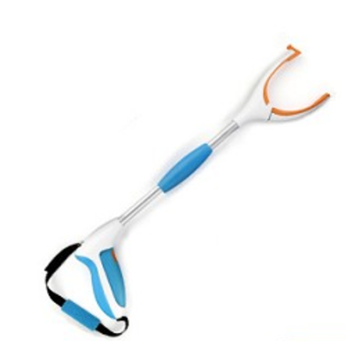
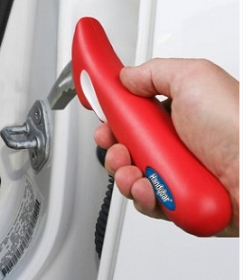
Arthritis
Assistive Techs:
  To get around:
    Cane/crutch
    Orthotics
    Braces/Splints
    Reachers
    Taller chairs
  http://www.arthritissupplies.com/
  Kitchen:
    Double handed pots
    Electronic can/jar openers
    Larger knobs and levers

Slide 10
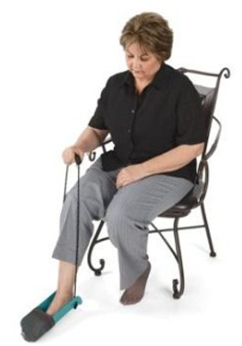
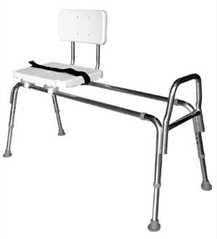
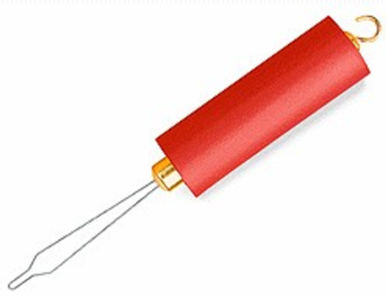
Arthritis
  Bedroom:
    Large buttons, hooks, closers
    Voice activated lamp
    Sock aids
    Zipper pulls
  Bathroom:
    Grab bars
    Shower chair

Slide 11
Obesity
Symptoms:
  Increases likelihood of: hypertension, high cholesterol, Type 2 diabetes, coronary heart disease, stroke, gallbladder disease, some cancers, mental illness, and osteoarthritis Sleep apnea and breathing problems
  Body pain
  Difficulty with physical functioning
Video:
https://www.youtube.com/watch?v=Jb8mPchIyfE
Notes:
https://www.cdc.gov/obesity/

Slide 12
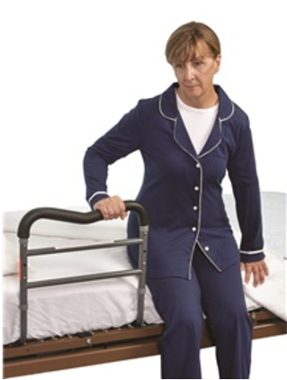
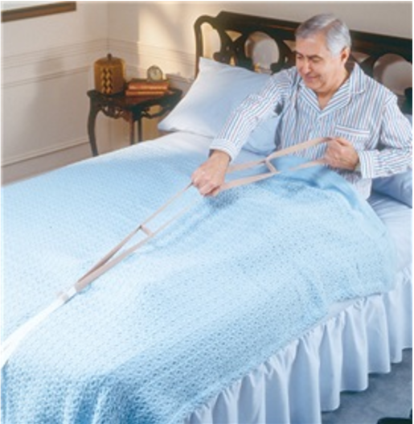
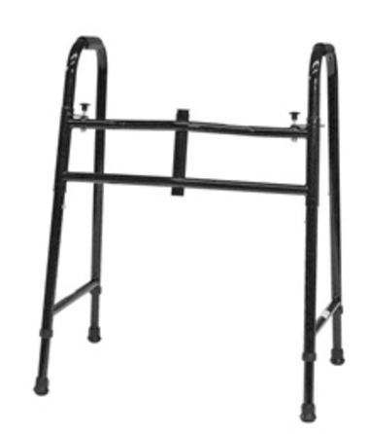
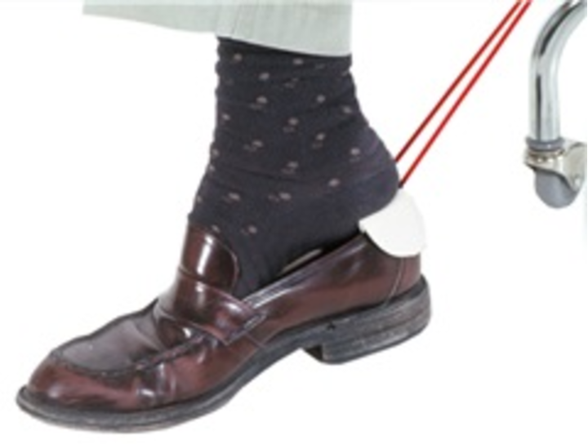
Obesity
Assistive Techs: food/diet apps,

Slide 13
Migraine
30.3% of adults suffer from severe headache or migraine
Symptoms:
  Moderate to severe headaches
  Headaches on one side of your head only
  Pulsating headache pain
  Headaches aggravated by routine physical activity
  Headaches that cause nausea, vomiting or both
  Headaches coupled with sensitivity to light and sound

Slide 14
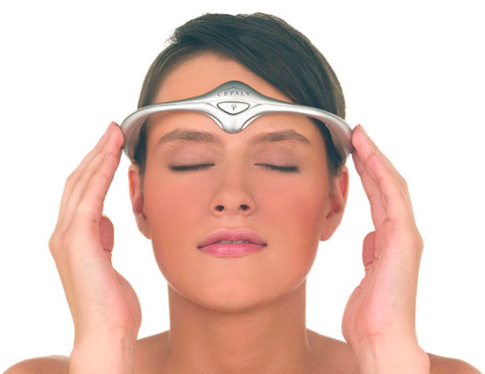
Migraine
Assistive Techs:
  Anti-glare filter for computer monitor
  Air purification systems (for fragrance triggers)
  Sunglasses
  http://www.cefaly.com/
  Apps:
    Brainwave tuner
    Binaural Beats therapy
    iHeadache/Headache Diary

Slide 15


Questions???

