Slide 1
Motor Disabilities
Angela Vujic
CS 8803
Notes:
Topic of discussion: motor disabilities

Slide 2
Discussion Outline
Definition
General Statistics
Types of Motor Disabilities
Examples of disabilities, technologies
ITA: Bonus Video
Notes:
My intention is not to lecture, rather, to establish a context to discuss AT for individuals with motor disabilities

Slide 3
Definition
Physical impairments that can impede movement, coordination, or sensation
Notes:
Just to get on the same page here
Does anyone have an addendum? Edit?

Slide 4
CDC National Health Survey
Difficulties in physical functioning
Example of measures included:
  Very difficult or cannot walk a quarter of a mile
  Very difficulty or cannot grasp or handle small objects
  Very difficult or cannot push or pull large objects
For Adults aged 18 and over:
  At least one basic actions difficulty or complex activity limitation: 74.8 million or 32.4%
  Unable (or very difficult) to walk a quarter mile: 17.1 million or 7.1%
  Any physical functioning difficulty: 36.2 million or 15.5%
Notes:
- broader idea of statistics of physical impairments in general
- Unfortunately the statistics did not also include specific types of impairments
- Selected 3 of 10 measures to give us a general idea

Slide 5
Selected characteristic | Any physical difficulty¹
Total | 15.2 (0.26)
Sex
Male | 12.6 (0.34)
Female | 17.6 (0.36)
Age (years)
18–44 | 5.4 (0.26)
45–64 | 19.4 (0.50)
65–74 | 29.8 (0.90)
75 and over | 48.0 (1.16)
¹“Any physical difficulty” consists of a "very difficult" or "can't do at all" response to at least one of the nine physical activities shown in the remaining columns.
Notes:
- For a more specific idea of impact broken down by gender and age with standard error

Slide 6
CDC National Health Survey
Based on the format of the survey results, CDC is trying to say: strong positive correlation between age and motor disabilities
Notes:
- In other words, CDC is trying to say ‘getting old is the worst’

Slide 7
Types: Breakdown
Traumatic Injuries
Spinal cord injury
Loss or damage of limb(s)
Congenital Conditions
Cerebral palsy
Muscular dystrophy
Spina bifida
Diseases – Onset correlated with age
Arthritis
Parkinson's disease
Essential tremor
Multiple sclerosis
Diseases – Still a mystery
ALS (Lou Gehrig's Disease)
Source: WebAIM (http://webaim.org/articles/motor/)
Notes:
I will not cover all of these, which is why I have listed the source; instead, I will bring up a few interesting points related to a few of them

Slide 8
Types: Breakdown
Traumatic Injuries
Spinal cord injury
Loss or damage of limb(s)
Congenital Conditions
Cerebral palsy
Muscular dystrophy
Spina bifida
Diseases – Onset correlated with age
Arthritis
Parkinson's disease
Essential tremor
Multiple sclerosis
Diseases – Still a mystery
ALS (Lou Gehrig's Disease)
Source: WebAIM (http://webaim.org/articles/motor/)
Notes:
I will not cover all of these, which is why I have listed the source; instead, I will bring up a few interesting points related to a few of them

Slide 9
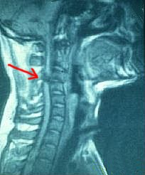
Spinal Cord Injury
Can result in paraplegia (paralysis of legs) or quadriplegia (paralysis of all 4 limbs)
Average age at injury: 31.7 years
The leading causes of spinal cord injury are as follows:
  motor vehicle accidents: 44%
  acts of violence: 24%
  falls: 22%
  sports: 8%
  other: 2%
Percent male patients: 75%*
*Do you think the gender statistics affect design & development of AT? Why or why not?
Notes:
- I’m going to hone in on spinal cord injury because I was fascinated by the gender imbalance – 75% male. My question to you is, do you think that affects the design of assistive technology, from development to the products that are available on the market right now? Why or why not?

Slide 10
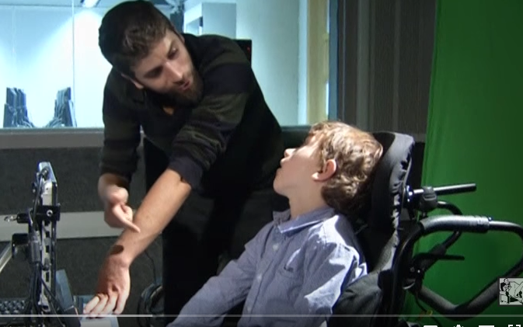
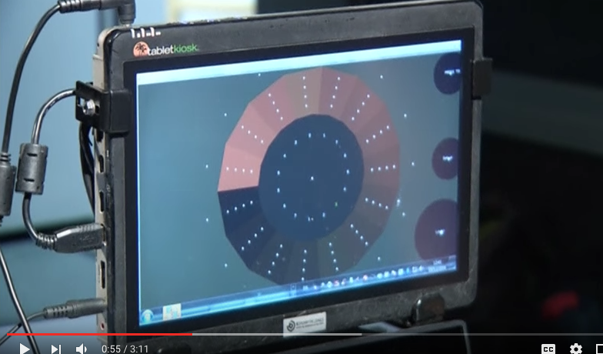
Cerebral Palsy
Symptoms generally appear in early childhood
Common characteristics include muscle tightness or spasm, involuntary movement, and impaired speech
Video, example technology: the Eye Harp*, a musical instrument controlled by eye tracking technology
*Thoughts? Have you developed or are currently developing similar technology?
https://www.youtube.com/watch?v=KKfNGGS5yCM

Slide 11
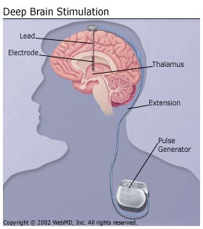
DBS for Parkinson’s Disease
Deep Brain Stimulation (DBS) implant delivers electrical stimulation to targeted areas to block abnormal nerve signals associated with PD*
Cannot cure or stop progression of PD
*When do you consider it ethical to surgically implant assistive technology – particularly in the deep brain?
Notes:
Something studied by many ethicists is the rise of brain implants for a variety of motor disabilities…

Slide 12
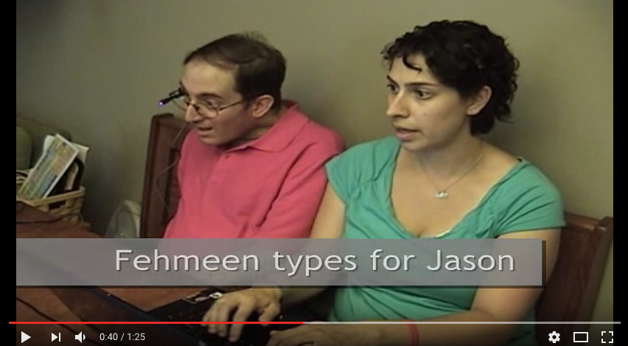

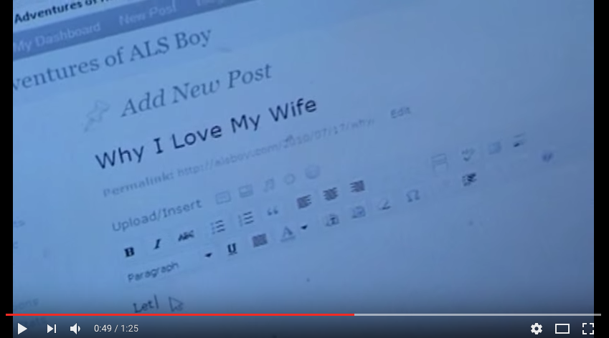
ALS
Progressive neurodegenerative disease that affects nerve cells in the brain and the spinal cord
Video, example technology: Low tech communication and interdependence*
*From surveys see that despite the numerous hi-tech options available (most developed from in-lab research), most individuals rely on low-tech forms of communication because they are affordable and reliable. Is it your responsibility as a researcher to ensure your accessibility technology research is accessible?
https://www.youtube.com/watch?v=z7lo0XuxywY
Notes:
Quick aside, ALS Association hosted the viral/famous Ice Bucket Challenge

Slide 13
Any other questions or comments?

Slide 14
Bonus
https://www.youtube.com/watch?v=f31m5-5-xUY *
*Why are dogs perfect?

